Slide 1
DIAS: Decentralized Internet Applications and Services
Final Project Presentation
3/13/14
Adriana Flores
Clayton Shepard
Ellis Giles
Yanda Lu
Haiuhua Shen

Slide 2
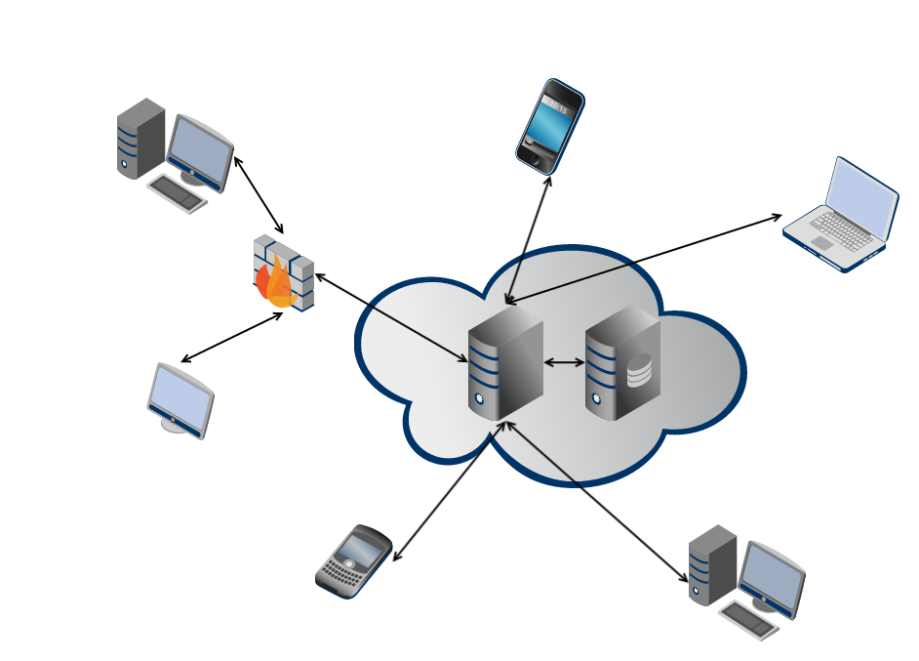
Problem: Centralized Architecture
Single point of failure
Privacy
Security
Control over data
Energy efficiency
Power hungry data centers
Google: 260 million watts [1]
[1] Glanz, James . “Google Details, and Defends, Its Use of Electricity.” The New York Times 8 Sep. 2011
Notes:
. Use 2 minutes to remind audience the problem/question that you want to address
====
centralized servers have many drawbacks, ranging from
privacy, security, and fault-tolerance, to even energy-efficiency and control over data
Power-hungry data centers
According to Google their global data center operation electrical power ranges between 500 and 681 megawatts.
quarter of the output of a nuclear power plant
Decentralize the current server-client mode paradigm in the current Internet

Slide 3
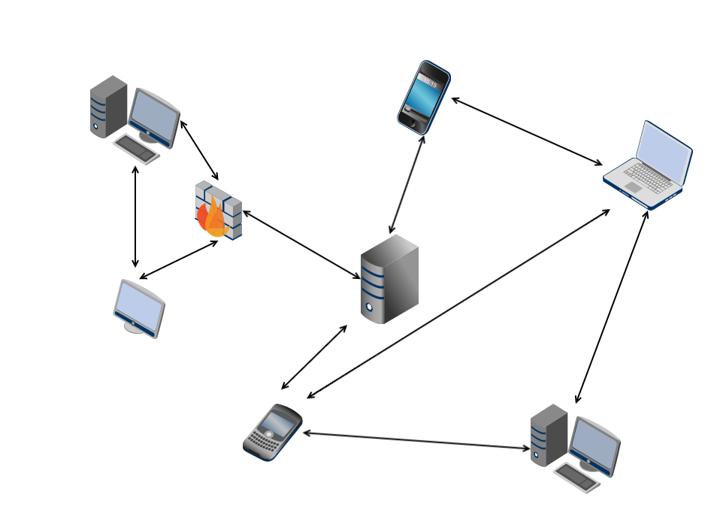
Decentralized Architecture
Robust to failure
Single point of failure
Full ownership and storage of your data
Privacy
Security
Control over data
Self-devices energy consumption
Energy efficiency
Power hungry data centers
Google: 260 million watts [1]
Notes:
. Use 2 minutes to remind audience the problem/question that you want to address
====
centralized servers have many drawbacks, ranging from
privacy, security, and fault-tolerance, to even energy-efficiency and control over data
Power-hungry data centers
According to Google their global data center operation electrical power ranges between 500 and 681 megawatts.
quarter of the output of a nuclear power plant
Decentralize the current server-client mode paradigm in the current Internet

Slide 4
DIAS: Decentralized Internet Applications and Services
Goal:
Decentralize the current server-client model
Replace servers with point to point communication for personal communication and services
Benefits:
Security, Privacy, Resilience, Cost, and Power
Challenges:
Redundancy, Uptime, Failover, Battery Management
Goal:
Decentralize the current server-client model
Replace servers with point to point communication for personal communication and services
Benefits:
Challenges:
Security
Privacy
Resilience
Cost
Power
Redundancy
Uptime
Failover
Battery Management
Notes:
. Use 2 minutes to remind audience the problem/question that you want to address
=========
How do we ensure reachability?
What happens if the cellphone loses connectivity?
What if it is lost/broken/stolen?
We need to find novel methods to ensure redundancy for both uptime and data.
Redundancy
Uptime
Data

Slide 5
DIAS Architecture
Ellis
Notes:
. Use 10 minutes to explain in detail your solution or approach to address the problem/question

Slide 6



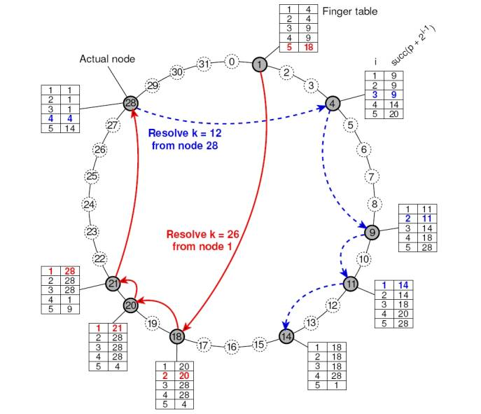
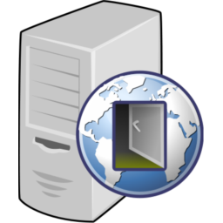
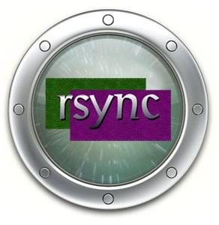
DIAS Implemented Services
Web – Nano and iJetty
Email - JES
SSH
Proxy
P2P
Web
SSH
Email
Peer to Peer
Proxy
Replication

Slide 7
DIAS: Web Server
Yanda
Ellis

Slide 8
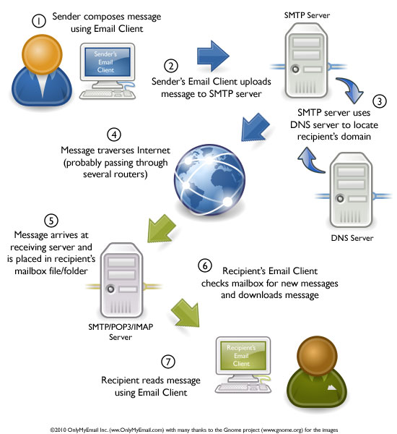
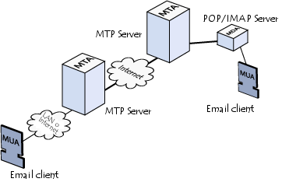
DIAS: Email Server
MTA: Mail Transport Agent
MTAs communicate with one another using the protocol SMTP
MDA: Mail Delivery Agent
POP3 (Post Office Protocol)
IMAP (Internet Message Access Protocol)
MUA: Mail User Agent
Notes:
MTAs tasked with transporting emails
The recipient's MTA then delivers the email to the incoming mail server (called the MDA)
MDA is protected by a user name called a login and by a password.
MTAs act as the post office
the sorting area and mail carrier, which handle message transportation
MDAs act as mailboxes, which store messages (as much as their volume will allow) until the recipients check the box.

Slide 9
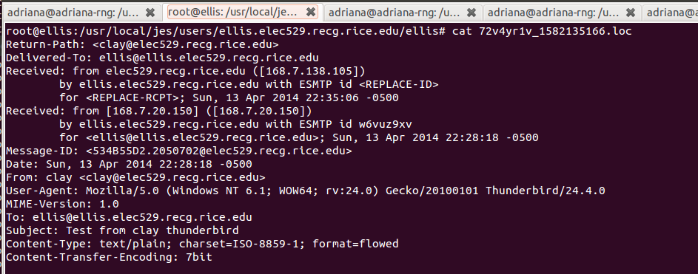
JES – Java Email Server
JES is a multi-featured hybrid MTA/MDA server written in the java programming language
Secure socket connections:
TLSv1, SSLv3
Authentication mechanisms:
SASL PLAIN, LOGIN, CRAM-MD5, DIGEST-MD5, SCRAM-SHA1, GSSAPI
Use filesystem to store emails

Slide 10
JES – Java Email Server
Mail.xml
Domains
Users
Passwords
JES-DNS
In-house software library to resolve IP and dns names
Logger
JES allows commons-logging
log4j
Mail.sh
Execute JES from command line
JAVA_EXEC
JES_HOME
Service Wrapper
Wrapper.conf
Starting JES
Security
Java Cryptography Extension (JCE)
JES Vault & Master Password
JSSE keystore password
STARTTLS SMTP/POP3 extension
Configuration Manager BackEnd
Domains, users and digest-MD5 realms
File system or Database

Slide 11
DIAS: SSH Server
Clay

Slide 12
DIAS: Proxy Server
Ellis

Slide 13
DIAS: Peer to Peer
Haihua
Ellis

Slide 14
DIAS: Replication
Clay

Slide 15
DIAS: Android APP
MAIN TAB…
Ellis & adriana

Slide 16
DIAS DEMO
Download of APP in this website:
Set your device name:

Slide 17
DIAS DEMO
Try Web Service:
Try SSH Service

Slide 18
DIAS DEMO
Failover
Recovery

Slide 19
Summary
Take-home points
Lessons learned
Future Directions
Conclusions
Notes:
. Use 3 minutes to summarize take-home points, discuss lessons learned, future directions, and conclusions

